Slide 1
TechnoKart:
Project Report

Slide 2
Business Overview
Total Bill
Total Orders
Avg Delivery Charge
Avg Order Price
11.0 M
500
76.13
22053.44
Month of high orders
Preferred Order Type
Max Coupon Discount
% Customer Satisfaction
May
Prepaid
154
52.4%

Slide 3
Metrics

Slide 4
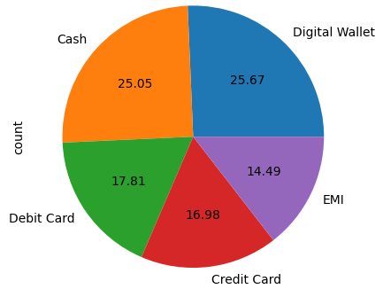
Preferred Order Payment for Customers
Observations / Findings
Preferred Order Payment: Digital Wallet
Percentage of Order Payment done through Digital Wallet: 24.67

Slide 5
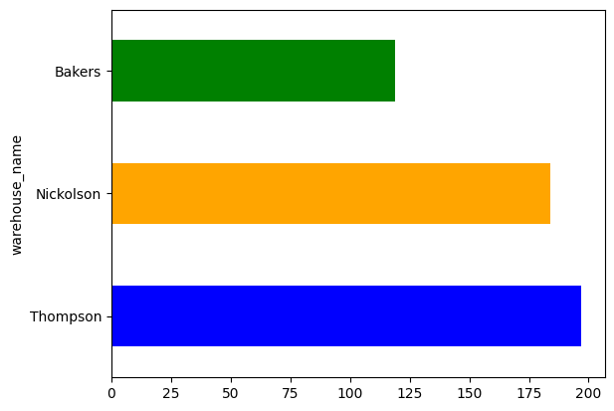
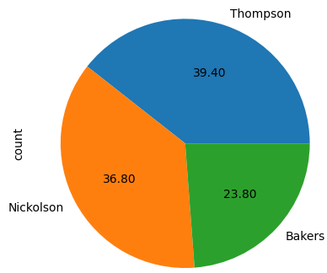
Major Deliveries Done from which Warehouse
Observations / Findings
Major Deliveries from Warehouse: Thompson
Percentage of Major Deliveries from Warehouse: 38.8560157790927

Slide 6
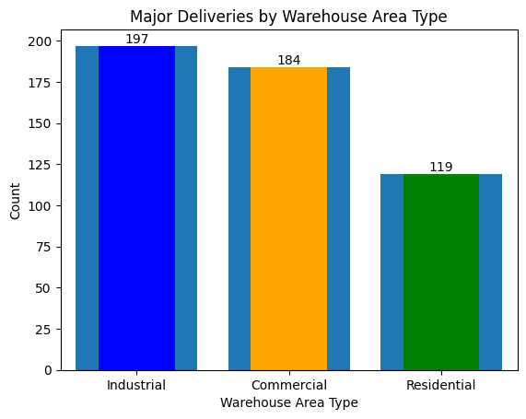
Major Deliveries Made from which Warehouse
Observations / Findings
Major Deliveries from Warehouse Area Type: Thompson
Percentage of Major Deliveries from Warehouse Area Type: 38.86

Slide 7
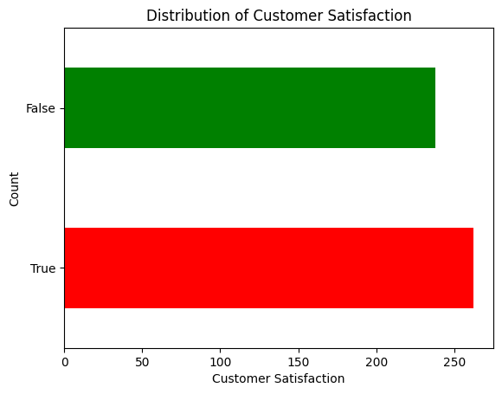
Distribution of Customer Satisfaction
Observations / Findings
Most Common Customer Satisfaction Level: True
Percentage of Customers with the Most Common Satisfaction Level: 52.40%

Slide 8
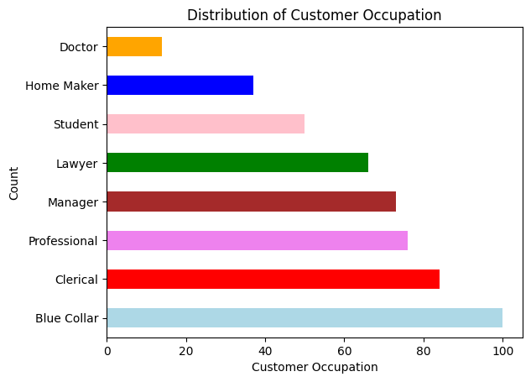
Distribution of Customer Occupation
Observations / Findings
Most Common Customer Occupation: Blue Collar
Percentage of Customers with the Most Common Occupation: 20%

Slide 9
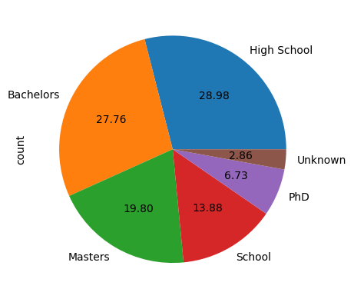
Distribution of Customer Education
Observations / Findings
Most Common Customer Education: High School
Percentage of Customers with the Most Common Education: 28.4

Slide 10
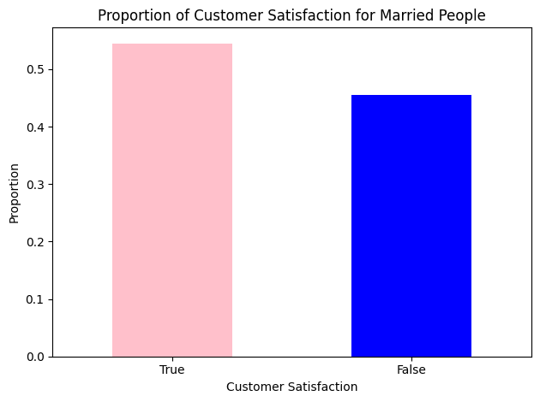
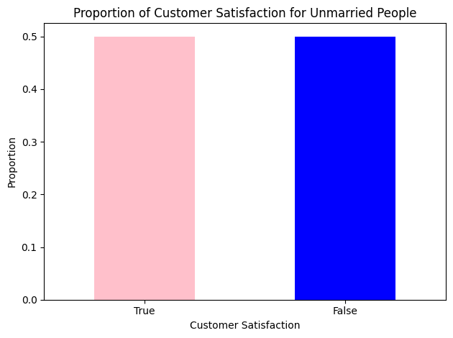
Proportion of Customer Satisfaction for Married
People
Observations / Findings
Percentage of Customer Satisfaction for Married Customers: 54.51%
Percentage of Customer Satisfaction for Unmarried Customers: 50.0%

Slide 11
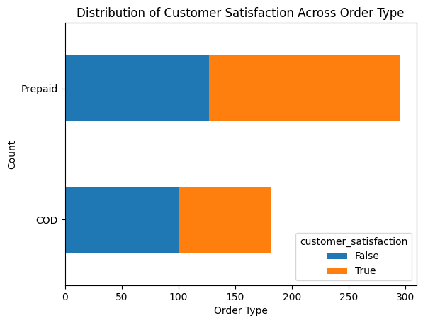
Distribution of Customer Satisfaction Across Order Type
Observations / Findings
From the chart, we can observe the following:
For the "COD" (Cash on Delivery) order type, the majority of customers are satisfied, with a smaller proportion being dissatisfied.
The "Prepaid" order type has a higher proportion of satisfied customers compared to dissatisfied customers.
The "EMI" (Equated Monthly Installment) order type has a relatively balanced distribution of satisfied and dissatisfied customers.
The "Digital Wallet" order type shows a similar distribution pattern to the "COD" type, with more satisfied customers than dissatisfied customers.
Overall, it appears that the majority of customers across all order types are satisfied with their purchases. However, further analysis and investigation would be required to understand the reasons behind customer satisfaction or dissatisfaction and to identify areas for improvement in specific order types.

Slide 12
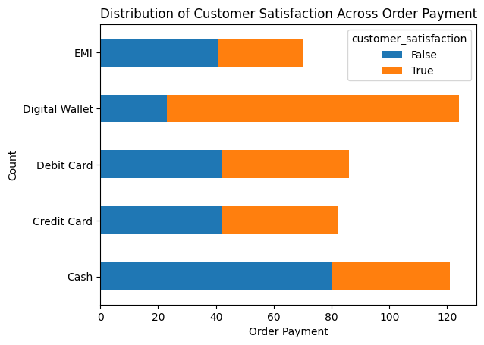
Observations / Findings
Distribution of Customer Satisfaction Across Order Payment
From the chart, we can observe the following:
Customers who paid with "Cash" on delivery (COD) have more satisfied customers than dissatisfied customers.
The "Prepaid" order payment method also has more satisfied customers than dissatisfied customers.
Customers who paid through "Debit Card" or "Credit Card" show a relatively balanced distribution of satisfied and dissatisfied customers.
The "Digital Wallet" order payment method shows a similar pattern to "COD" and "Prepaid," with more satisfied customers than dissatisfied customers.
Overall, the majority of customers across different order payment methods seem satisfied with their purchases. However, further analysis and investigation would be necessary to understand the factors influencing customer satisfaction and identify areas for improvement in specific order payment methods.

Slide 13
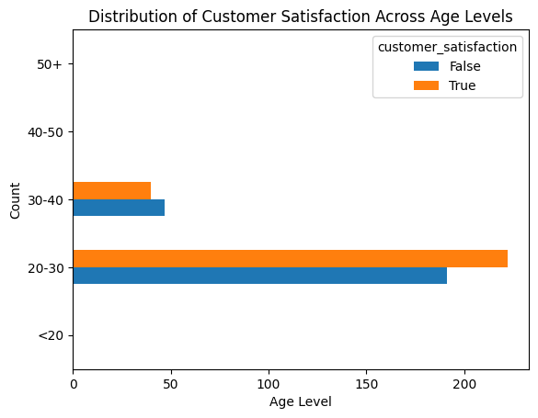
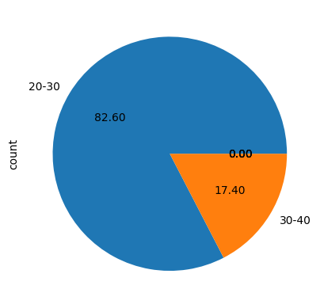
Distribution of Age Level Customer Satisfaction
Observations / Findings
Customers below the age of 20 ('<20') and in the age range of 20-30 show a higher proportion of satisfied customers than dissatisfied customers.
The age group of 30-40 demonstrates a relatively balanced distribution of satisfied and dissatisfied customers.
Customers aged 40-50 and 50+ exhibit a higher proportion of dissatisfied customers than satisfied customers.

Slide 14
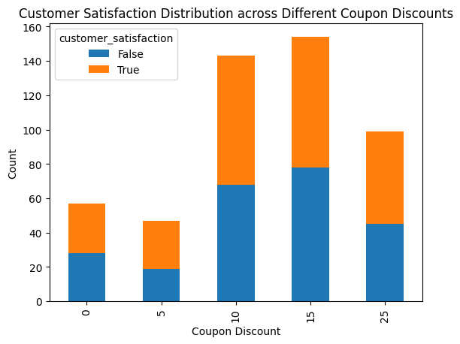
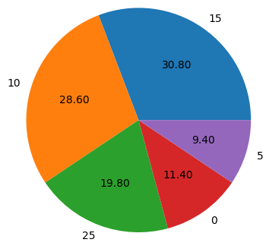
Customer Satisfaction Distribution across Different Coupon Discounts
Observations / Findings

Slide 15
Insights and Recommendations

Slide 16
Insights
Number of rows: 500
Number of columns: 19
Average order price: 25415.54
Total delivery charges: 37303.12
Maximum customer satisfaction: True
Number of expedited deliveries: 249
Total bill: 11026722.24

Slide 17
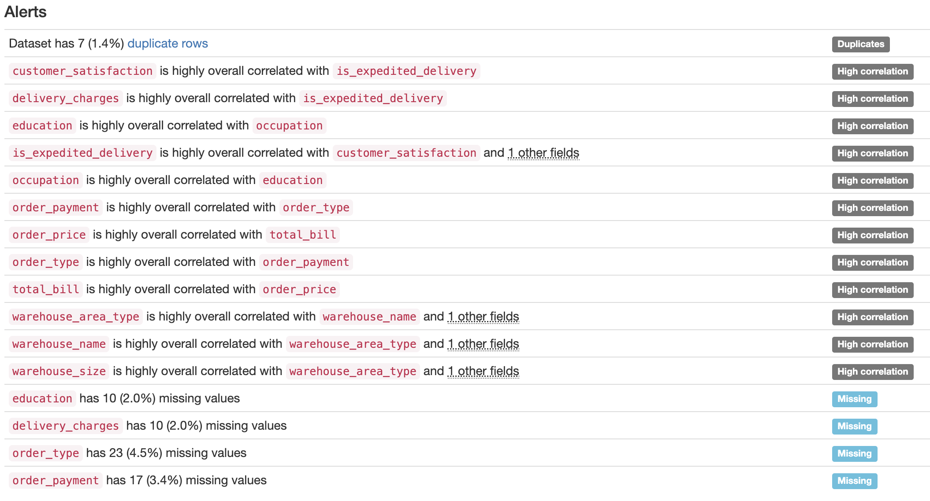
Recommendations

Slide 18

Pandas Profiling Report

